Slide 1


Slide 2
Flip-Flops
The flip-flops are basically the circuits that maintain a certain state unless and until directed by the input for changing that state
Types of Flip-Flops
The flip-flops are of the following types:
1. S-R Flip Flop
2. J-K Flip Flop
3. T Flip Flop
4. D Flip Flop

Slide 3
The flip-flop is a circuit that maintains a state until directed by input to change the state.
A basic flip-flop can be constructed using four-NAND or four-NOR gates.
A flip-flop is popularly known as the basic digital memory circuit.
It has two states as logic 1(High) and logic 0 (Low) states.
A flip-flop is a sequential circuit which consists of a single binary state of information or data.
The digital circuit is a flip-flop which has two outputs and are of opposite states. It is also known as a Bistable Multivibrator.

Slide 4
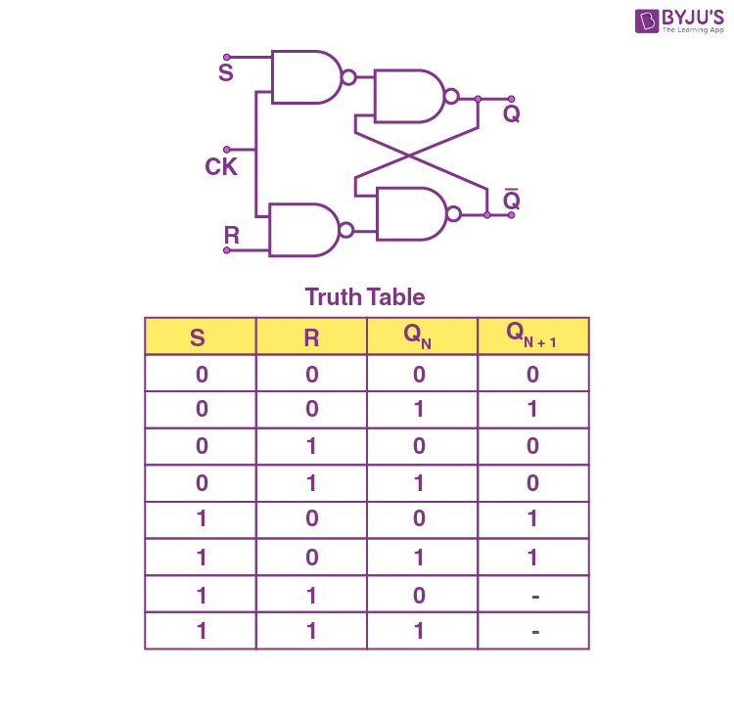
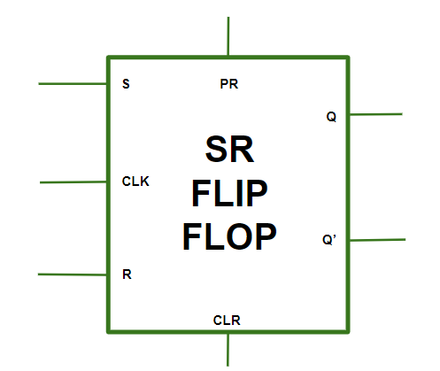
RS -Flip Flop

Slide 5
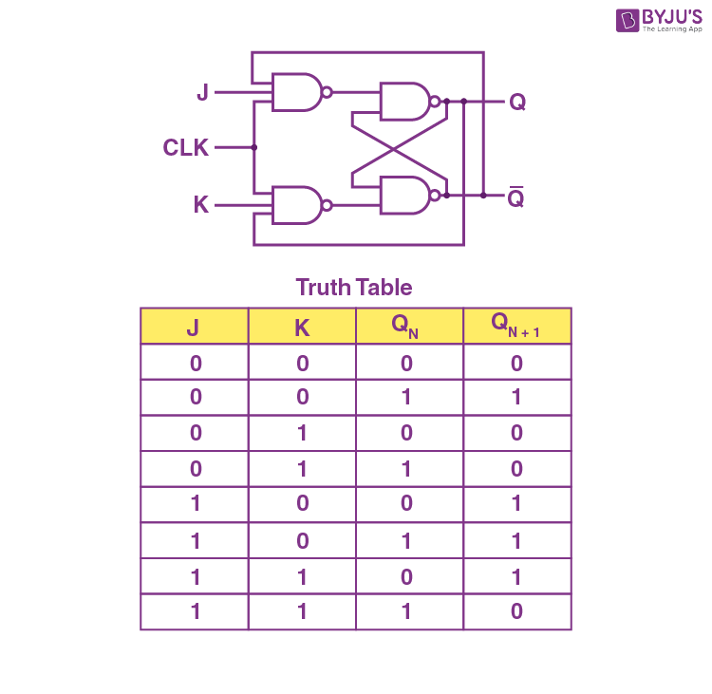
JK- Flip Flop

Slide 6
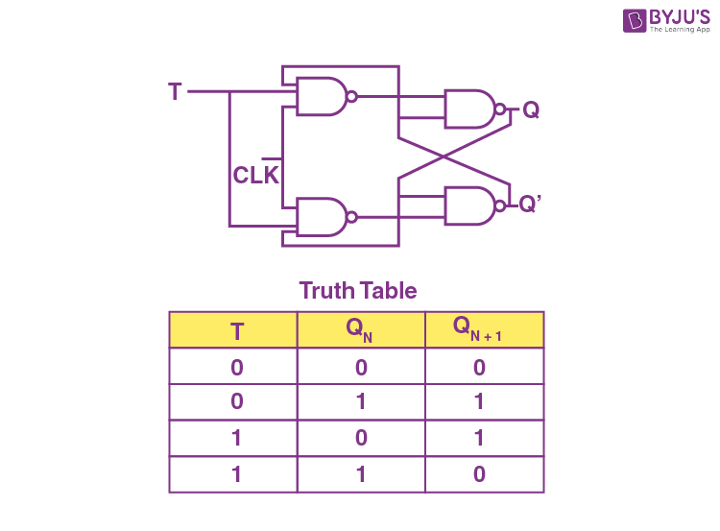
T- Flip Flop

Slide 7
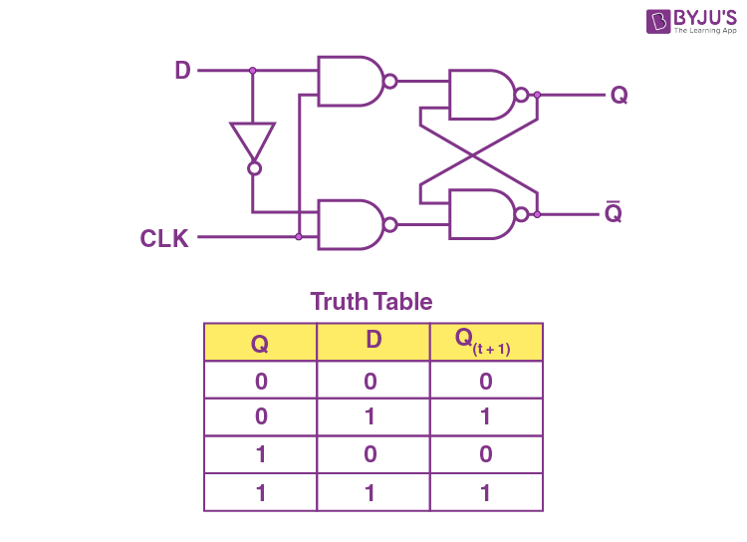
D- Flip Flop

